Slide 1

PC builder web application
Team member:
Kevin Song
Siyuan He
Xu Zhang
Haimiao Yu
Chhanna Gaha
Sichao Liu
Guided By: Professor Henry Wong
Deliverable IV
Team Name: Dice

Slide 2

Introduction
A new application is made if a developer produces a new idea or when there is new technology to create better software. Our team viewed many existing online PC hardware stores, they are either created with older development tools or lacking functions that we need nowadays.
Therefore, we are here with a web application that is developed using React and other advanced technologies to achieve smooth browsing and satisfying functionality. This web app will guide students and users who have less experience on PC hardware to pick the right parts. Also, it will help experienced PC shoppers fulfill their dream of building their own pc.

Slide 3
Persona of a college Student
Hi, I am Nancy studying Bachelor's in Computer Science at North Georgia University. It’s difficult for me to pick a laptop out of many brands. There are ASUS, MSI, Dell and so many famous brands with similar hardware specs. I wish there is a good online application to help me identify which brand has the best hardware with the best price.

Slide 4
Persona of a software engineer
Hi, I am Jz Han. I am an experienced IT worker living in the Georgia suburb. In Georgia, the retail store is far away from where I live so I always shop for PC parts online. However, the websites that I am familiar with are only office related. They do sell PC hardware but it’s not their major business. I wish there was a web application that would just focus on selling PC parts. It would need to have a clear category breakdown and run smoothly just like any other shopping website.

Slide 5
Persona of a FilMmaker
Hi, my name is Mark. I’m an MFA of Filmmaking in the School of Visual Arts in New York. Next semester I will take classes related to video editing and color correction and I’m using 4K videos instead of 1080p videos. So I’m changing my main editing tool from Adobe Premiere to Davinci Resolve. I have a great Gaming Desktop and it worked well with Premiere, but after moving to Davinci it runs much slower. I was told that different professional software sometimes make more use of different components of the PC. When I was trying to find which part of my PC should be replaced, I found that all the current PC building websites separated their PC builds into categories like gaming PC, creator PC, or office PC. It would be helpful to have a PC Building website which can make buying suggestions based not only on the main use, but also based on the specific workflow and tools.

Slide 6
Persona of a Gamer
Hi, I am Jessi, a Bachelor at Pace University. I’m a big fan of AAA PC gaming so I plan to buy a powerful laptop which can be used for heavy gaming as well as course work. The existing PC websites only show the specs of the laptops. However, the gaming performance is not only related to the specs on the laptop. The thermal strategy, TDP settings, power management, and even pre-installed software will affect the gaming performance in the real world. These detailed information are not shown on existing websites. It would be great to have a website to show me the real gaming performance of each laptop to help me make purchase decisions.

Slide 7
MVP
Which problem does it solve?
For the customers who are not familiar with the computer specs and components, it is difficult to choose the right PC builds or laptops that meet their needs.
Minimum:
A website which allows customers choose and buy PC components and laptops for meeting their different needs.
Viable:
A tool which can give useful and accurate information of the PC components and laptops. Also the tool can give customers advice for different use.
Minimum + Viable:
We are presenting a product which can provide real world performance information of PC and give suggestion to the customers for different use when they buy PC and laptops.

Slide 8
Product backlog
Priority | Sprint | User type | I want to be able to… | So that … | type | status
1 | I | Developer | Install development tool | Team can start writing the app
2 | I | Developer | Design Website Template | Team can plan on HTML, CSS
3 | I | Developer | Install communication platform | Team members are free to communicate
4 | II | User/Admin | Have a website | I can view/order items, create profile… | epic | ip
5 | II | User/Admin | Visualized Product Components | I can display images and their info on website | epic | done
6 | II | User/Admin | Have detailed Product Page | I can click on product to check their detail | story | done
7 | II | User | Have Shopping cart | I can check purchased product | epic | done
8 | III | User/Admin | Register | I can use my profile to perform such as buying…. | story | done
9 | III | User/Admin | Login/Log out securely | My account is private | story | done
10 | III | User | Display added items on cart icon | I can see number of items in cart | story | done
11 | III | User/Admin | Edit qty of item in both product and check out page | I can freely edit item numbers. | story | done
12 | IV | User | Enter name and shipping address | I can have name and shipping stored in profile | story | done
13 | IV | User | I want to check out and have an order number | I can wait for my order | epic | done
14 | IV | Admin | I want to see order placed by customer | I can send order by shipping address | story | done

Slide 9
Product backlog
Priority | Sprint | User type | I want be able to … | So that… | type | status
15 | V | User | Have profile displayed | I can see my profile | story | Failed
16 | V | User | Update my profile info | I can freely edit profile and save | epic | In work
17 | V | Admin | List Product | I can see all order in list | story | Done
18 | VI | Admin | Create Product | I can create product on website | epic
19 | VI | Admin | Edit customer’s profile info | I can fix customer’s profile issue | epic
20 | VI | Admin | Update product | I can edit product info on website | story
21 | …
22 | …
23
24
25
26
27
28

Slide 10
Acceptance Criteria
User Story | Accepted Criteria
#15 As a User, I want to be able to have profile displayed | User can click on his or her name tag to open drop-down menu which includes display profile button. User click on button will bring user to the profile page with correct user profile displayed.
#16 As a User, I want to be able to Update my profile info | In the user profile page, user can edit information including Name, Email, Password and click on update button to have new info saved.

Slide 11
Acceptance Criteria
User Story | Accepted Criteria
#17 As an Admin, I want to be able to List products | Admin user can view every customer’s order in a list by clicking List product button in its drop-down menu.

Slide 12
Test Case
# | Process | Test Case | Description | Status | Expected Result | Actual result
15 | Profile displayed | Click on user profile button | Mouse hang on logged in user’s icon. | Passed | A drop-down menu show user profile pop up | The menu pop up with correct word
 |  |  | Move mouse to user profile button and click on it | passed | A form with user information showed up | A form with correct user information showed up
16 | Update Profile | Click on update button | In user profile page, fill in different user info and click update | Failed | User should have new info record in database and display correct name on icon | No data change
17 | List product | Click on List product button | Login as admin | passed | Current user should replace by admin user | Admin user successfully logged in.
 |  |  | Move mouse to admin icon | passed | A drop-down menu show List product showed up | The menu pop up with correct word
 |  |  | Move mouse to List product button and click on it | passed | A form shows all current order showed up | The form show up with correct information

Slide 13




Technologies we used

Slide 14
Sprint backlog
Team Dice Deliverable I
Product back log Item | Tasks | Started Tasks | Status/vote
Install development tools | 1 Install React, Node js 2 Install extension, add on, any tool that may helpful. | 1, 2 | 1,2 Done/6
Design Website Template | 1 Install React, Node js 2 Install extension, add on, any tool that may helpful. | Write CSS code for product list and website | Done/6
Install communication tool and platform | 1 Install WhatsApp 2 Install GitHub | Install all necessary tools for good team communication and project management 1,2 | 1,2 Done/6

Slide 15
Sprint backlog
Team Dice Deliverable II
Product back log Item | Tasks | Started Tasks | Status/vote
Have a website | 1 Create a react app and write code for front end. Test frontend. | Created a react app and tested. | Done/6
Visualized Product Components | 1 Build a product list. 2 Build product screen page. 3 Test by display local photo. 4 Create Node server. | Created product list and product screen. Create Node server and load products from backend. 1,2,3,4 | 1,2,3,4 Done/4
Have detailed Product Screen | 1 Add router In homepage, 2 create product page. 3 Add new routing point to product page. 4 Install Redux and add it to product page | Install route function in react Create product page and add redux. 1,2,3,4 | 1,2,3,4 Done/5
Have Shopping cart | 1 Add new routing point to cart. 2 Create cart page. | Create cart page Add new routing point to the cart icon button. 1,2 | 1,2 Done/6

Slide 16
Sprint backlog
Team Dice Deliverable III
Product back log Item | Tasks | Started Tasks | Status/vote
Register | Create user authentication function. | 1 Create register page and duplicate one for login/log out page. 2 Finish editing both. Implement authentication action. | 1,2 Done/6
Login/Log out in secure | Create private route for admin user | Create admin view. | Done/5
Display added items on cart icon | 1 Implement add to cart action 2 Implement remove from cart action | 1,2 | 1,2 Done/5
Edit qty of item in both product and check out page | 1 Finish design CSS code for product page 2 Write code for check out page. | 1,2 | 1,2 Done/4

Slide 17
Sprint backlog
Team Dice Deliverable IV
Product back log Item | Tasks | Started Tasks | Status/vote
Enter name and shipping address | Create Shipping Page | 1 Create shipping fields 2 Implement shipping constant actions. | 1, 2 Done/6
I want to check out and have an order number | 1 Create Place Order Page 2 Create Place Order API 3 Implement Place Order action 4 Write function to generate ID | 1 Design order summary fields 2 Create API for place Order 3 Create order action 4 Write method to generate user ID | 1,2,3,4 Done/5
I want to see order placed by customer | Display Orders History | 1 Create OrderHistory Page Set new route 2 Create customer orders API | 1 OrderHistory Page not finish 2 Done/5

Slide 18
Sprint backlog
Team Dice Deliverable V
Product back log Item | Tasks | Started Tasks | Status/vote
Have user profile displayed | 1 Create new route in backend to return user info by ID 2 Create ProfilePage 3 Define User Constant 4 add ProfilePage button to user’s drop-down menu | Add new route in backend Create ProfilePage to show form of user info 1,2,3,4 | 1,2,3,4 Done/ 6
Update profile info | 1 Add Update button 2 Create API to update profile 3 Pass data from ProfilePage to updateProfile action | 1,2,3 | 1 Done 2,3 unknown database error/ 4
List Product | 1 Create ProductList Page 2 add ProductList function to admin’s drop-down menu 3 Set PrivateRoute | 1,2,3 | 1 More function including delete, edit will be add in future. 2,3 Done/ 5

Slide 19
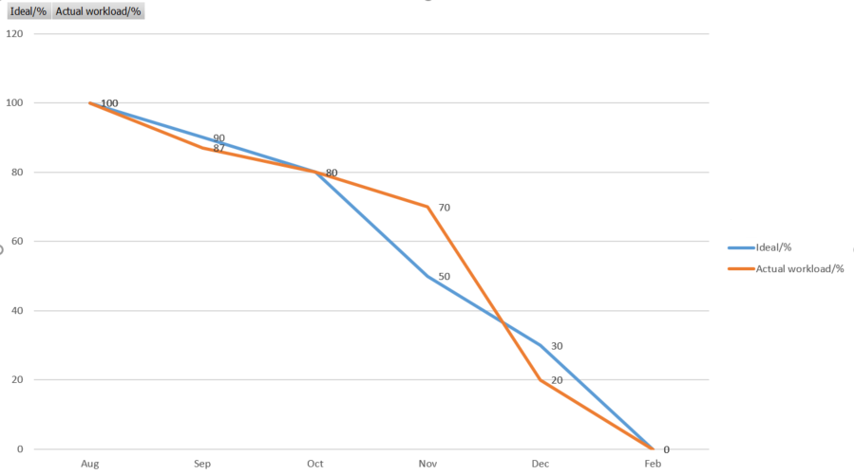
BURNDOWN CHART

Slide 20

Future scope
Give admin ability to edit user, product
User will have option to customize their pc.
A forum will be created as a community for our users.
Rating system.
Potential ability for user to chat with admin.
Optimization of the web page interface.

Slide 21

GitHub link
https://github.com/ksong227/CS691TeamDice
Thank You

